Slide 1
Scenix Virtual PeripheralTM Concept

Slide 2
Virtual PeripheralTM Concept
A ‘Virtual Peripheral’ can be defined as software that provides functions implemented on other as on-chip hardware blocks, or as additional hardware components.
Some common examples include:
  UART
  PWM
  Timers
  ADC
  DAC
  Modem
  DTMF I/O
  I²C Interface
  SPI/mWire
  And many, many more...

Slide 3
Virtual PeripheralTM Concept Cont’d
An application can be broken up into 3 distinct areas of code:
  Resource Allocation
    global registers for semaphores - flags, reference passing
    interface registers for each module
  Interrupt Service Routine (ISR)
    where the Virtual PeripheralTM real time tasks reside
  Subroutines
    any supporting or non-real time functions for the Virtual PeripheralTM

Slide 4
Virtual PeripheralTM Integration
Virtual PeripheralTM modules can be combined into one piece of software to be programmed into the SX.
The designer can choose the combination of Virtual PeripheralTM modules, within the following limits:
  RAM, ROM resources usage
  I/O usage
  MIPS required
Scenix literature publishes all of these specs with the release of each Virtual PeripheralTM

Slide 5
Integration Cont’d
Application
Software
The following example shows an
application which requires a
UART, 16-bit Timer and DTMF:
All registers are allocated in RAM
The ISR portions of each Virtual PeripheralTM are combined into one consecutively executed piece of code.
Any subroutines which are required are then added to the code.
RAM Allocation
Timer registers
DTMF registers
UART registers
Interrupt Service Routine
Timer
DTMF
UART
Main
Initialization
Main code logic
DTMF subroutines
UART subroutines

Slide 6
Integration Cont’d
Some Virtual PeripheralTM modules have very specific timing considerations, i.e.
  UART, for baud rate generation
  DTMF, for target frequency references
To ensure proper timing, the RTCC value used will need to be calculated.
  A formula is provided with each module which has specific timing needs to aid in choosing an RTCC value, or to adjust timing constants to a given RTCC.
When multiple modules are being used, each with different RTCC values, some modification may be required:
  A ‘common denominator’ may be found across all the modules
  Timing constants can be adjusted to a given RTCC.

Slide 7
Sources and Types of Virtual PeripheralTM
Telephony
DTMF Detection
DTMF Generation
FSK Detection
FSK Generation
Caller ID
Ring Detect
Call Progress Detect
Call Progress Generation
FSK 202 R2R
DTMF Generation R2R
Pulse Dial Receive
Pulse Dial Generation
Interface
I2C Master
I2C Slave
I2C Multi-Master
SPI/uWire Master Interface
SPI/uWire Slave Interface
2400-230.4K UART
Eight UART (19.2 Baud)
Scenix.com
Free Ware
@
www
Display
4-Bit LCD Interface
8-Bit LCD Interface
Driving 7 Segment LED
PWM Bar Graph
LCD Driver
Virtual Peripherals
Library
Signal
Dual 8-Bit PWM's
Eight 8-Bit PWM's
Sigma Delta ADC
Artificial Sine Wave
Generator
General
16-Bit Timer
4x4 Keyboard Scan
Real-Time Clock
Push Button Debounce
Your IP

Slide 8
SX Function Specific Solution:
Bell 202s Modem
Analog line
Analog line
PWM
PWM
DTMF
Detection
A/D
Converter
FSK
Detection
Ring
Detect
DTMF
Generation
FSK
Generation
Oscillator
SX28AC
8-bit uC Core
Caller
ID
Osc.1
Osc.2
In-system
programming
Brown-out
Detection
16-bit
Timer 1
UART
SPI
Interface
2K*12
FLASH
136 B
SRAM
Vcc
To RS232
SPI bus
Hardware Blocks
Virtual PeripheralTM

Slide 9
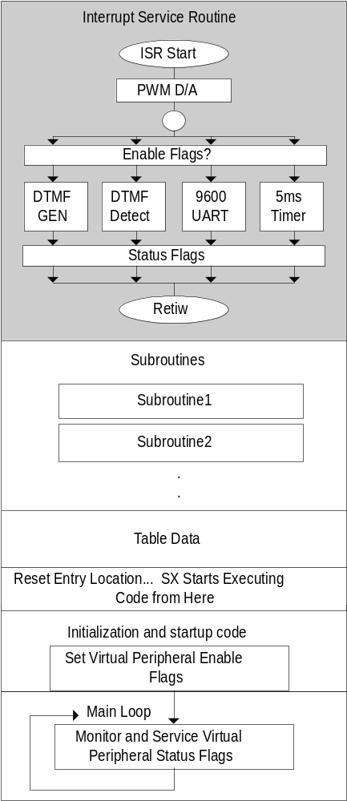
Structure of an application with Virtual Peripherals
Interrupt Service Routine at start of program space
  Virtual peripherals run in the Interrupt Service Routine
Subroutines Follow Interrupt Service Routine.
  Serve as the “API” to interface with ISR VP’s
Following any data is the resetEntry location.
  Program goes here on reset
The main Loop follows the initialization code. It contains the main application code.

Slide 10
Interrupt Driven Virtual Peripherals
Virtual peripherals take advantage of:
High Speed: Up to 100MIPS
Deterministic Interrupts:
  Jitter Free
  3 cycles (fixed) to enter an interrupt
  3 cycles (fixed) to exit an interrupt

Slide 11
Interrupt Driven Virtual Peripherals
Interrupt Driven Virtual Peripherals work by executing a small task on each pass of the ISR
Written to execute at a specific “Sampling Frequency”
Usually loopless. Repetitive tasks repeated in consecutive interrupts, rather than in a loop

Slide 12
Virtual Peripheral Example: Signal Generation
D/A Conversion Techniques
Interfacing the Software to the Real World.

Slide 13
Virtual Peripheral Example: Signal Generation
D/A Conversion Techniques
Hardware D/A Converter
Advantages
    Low I/O pin usage (serial D/A)
    Known Specifications
    Higher accuracy than most software techniques.
Disadvantages
    If it is not built into the microcontroller, it is much more expensive than R-2R or PDM/PWM solutions.
    Medium Software implementation (usually serially interfaced)

Slide 14
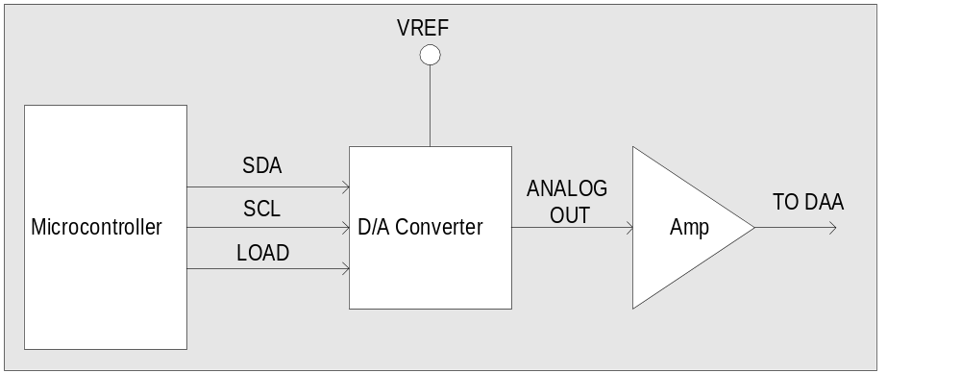
Virtual Peripheral Example: Signal Generation
D/A Conversion Techniques
Hardware D/A Converter

Slide 15
Virtual Peripheral Example: Signal Generation
D/A Conversion Techniques
R-2R Ladder
Advantages
    Minimal software implementation.
    Lower cost than hardware D/A converter.
    Faster and more accurate than software PWM/PDM solution.
Disadvantages
    Higher cost than PWM/PDM implementation due to more circuitry.
    Requires 1 I/O pin per bit of resolution.
    MSB needs to be very accurate (+/- 256⁻¹ for a practical 8-bit D/A.)

Slide 16
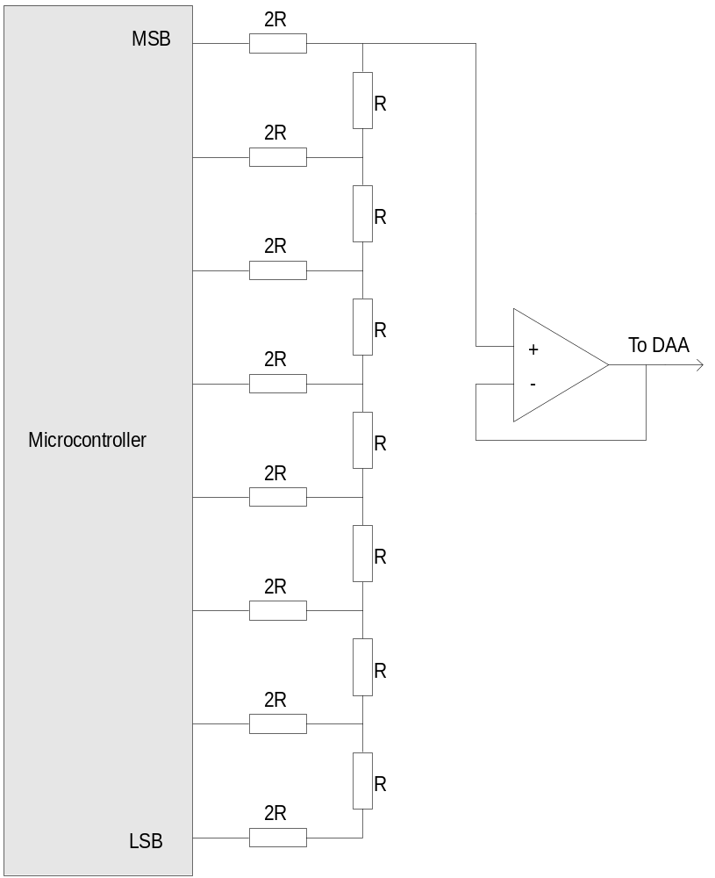
Virtual Peripheral Example: Signal Generation
D/A Conversion Techniques
R-2R Ladder
This circuit uses discrete components to generate an output that is proportional to the weighted sum of the input voltages.
One output pin is required for each bit of the conversion, so for an 8-bit D/A conversion, 8 pins on the microcontroller are required.

Slide 17
Virtual Peripheral Example: Signal Generation
D/A Conversion Techniques
PWM/PDM Generation
Advantages
    Minimal software implementation.
    Lowest cost of all solutions.
    Requires only a single output pin.
Disadvantages
    Needs high-speed processor with deterministic interrupt structure to run in background.
    Not suitable for high-sample-rate audio or high-resolution audio.

Slide 18
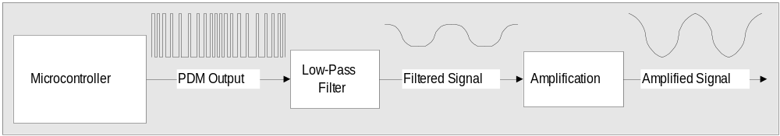
Virtual Peripheral Example: Signal Generation
D/A Conversion Techniques
PWM/PDM Generation
Pulse Density Modulation Block Diagram

Slide 19
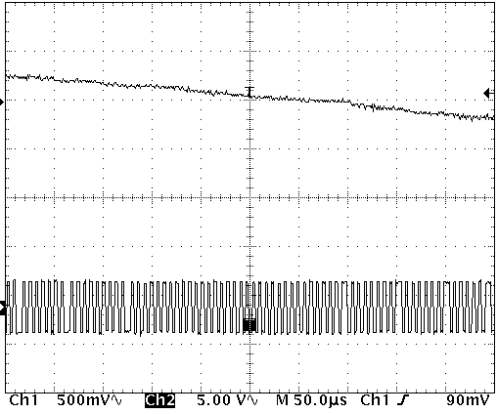
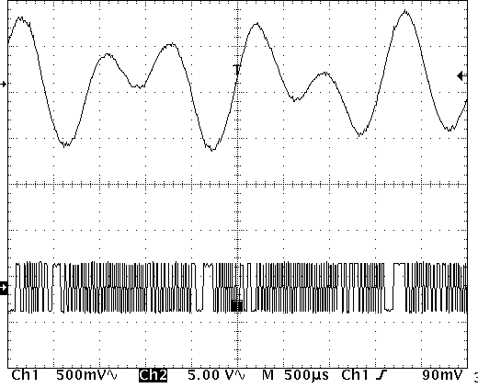
Virtual Peripheral Example: Signal Generation
PDM output used to create a DTMF signal
Integrating PDM output creates an analog signal

Slide 20
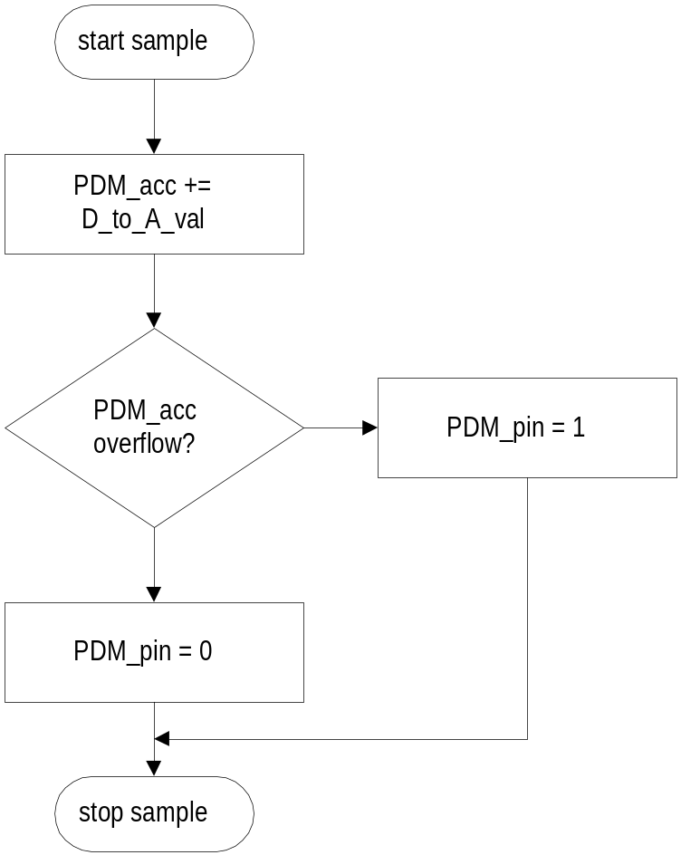
Virtual Peripheral Example: Signal Generation
D/A Conversion Techniques
PWM/PDM Generation
PDM_pin is set if adding the 8-bit D_to_A_val to the 8-bit PDM_acc register causes an overflow.
Notes:
This is a flowchart for generating a PDM signal. It assumes that PDM_acc and D_to_A_val are both 8-bit values.
Example of use: If PDM_acc starts out at zero and we run the routine 256 times for an 8-bit resolution value:
If D_to_A_val = 255: PDM_acc won't roll over on the first pass so we will get an output of zero on the PDM pin. The remaining 255 samples will all overflow and the PDM pin will be set 255/256 of the time.
If D_to_A_val = 128: every second add will cause an overflow and the PDM pin will be set 128/256 of the time
If D_to_A_val = 1: Only the very last addition will cause an overflow, meaning that the PDM pin will only have been set 1/256 of the time.

Slide 21
Virtual Peripheral Example: Signal Generation
;VP_begin: PDM D/A Conversion
PDM_output
;------------------------------------------------------------------------------
; Virtual Peripheral: Jitter-Free, Deterministic Pulse Density Modulation
; Input variable(s): PDM0_out: Value from 0 - 255 corresponding to DC
; voltage
; Output variable(s): Ra.0 pin is PDM output pin
; Variable(s) affected: PDM0_acc variable
; Flag(s) affected: None
; Program Cycles: 11 cycles (turbo mode SX28)
;------------------------------------------------------------------------------
_bank PDM_bank ;1 ; Update the PDM pin
add PDM0_acc,PDM0_out ;2,3 ; set PDM pin if carry
snc ;1,4
jmp :set_pin ;1,5 or 3,7 (carry)
:clear_pin
nop ;1,6 ; clear PDM pin (no carry)
nop ;1,7
clrb PDM_pin ;1,8
jmp :PDM_out ;3,11
:set_pin ;7 ; set PDM pin (carry)
setb PDM_pin ;1,8
jmp :PDM_out ;3,11
:PDM_out ; 11 PDM cycles total.
;VP_end: PDM D/A Conversion
;------------------------------------------------------------------------------

Slide 22
Virtual Peripheral Example: Signal Generation
Sine Wave Generation
using a Phase Accumulator

Slide 23
Virtual Peripheral Example: Signal Generation
  Two key variables:
    phaseAcc
      phase accumulator.
    freq
      constant that is added to the phase accumulator on every sample.
  freq = (2^{n} * Fs⁻¹ * desired frequency) where n is the number of bits in the phase accumulator and Fs is the sample rate.
  MSBs of phaseAcc is an index into a table of sine wave values. The more bits used, the greater the resolution.
Notes:
For example, to generate a frequency of 697 Hz, with a sample rate of 19200Hz and 16-bit phase accumulators and freq variables,
freq = 2^16 * (1/19200) * 697Hz
freq = 2379.09
Convert 2379.09 to hexadecimal
freq = 0x094b
To calculate how accurate the output frequency will be:
2379 / (2^16 * (1/19200) = 696.97Hz

Slide 24
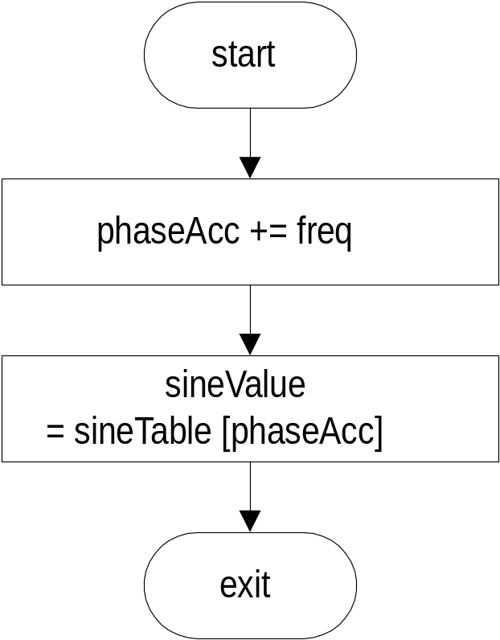
Virtual Peripheral Example: Signal Generation
Phase accumulator
flowchart for each
sample
EXAMPLE ASSEMBLER CODE
; 16-bit add to phase accumulator
add phaseAccLo,freqLo
snc ; if carry, increment upper byte
inc phaseAccHi
add phaseAccHi,freqHi
; use upper nibble of phase
; accumulator as index into sine
; table.
mov w,phaseAccHi
swap wreg ; swap nibbles of w
and w,#$0f ; keep the lower nibble
call sineTable; get sine value
; store new amplitude into D/A register
mov DtoAVal,w
Notes:
To produce each new sample of the sine wave, the freq variable is added to the phase accumulator, and the resultant new phase is used as an index into a table of sine values.
Use the upper bits of the phase accumulator as an index. For example, if the application only requires 4-values, use only the upper two bits (AND with 0xC000)
For a 256 value table, use the upper byte as the index.

Slide 25
Virtual Peripheral Example: Signal Generation
EXAMPLE SINE TABLE
;*****************************
sineTable
; returns with values in the
; range of +/- 32 in the w
; register. Uses w register
; as an index into the table
;*****************************
jmp pc+w
retw 0
retw 12
retw 23
retw 30
retw 32
retw 30
retw 23
retw 12
retw 0
retw -12
retw -23
retw -30
retw -32
retw -30
retw -23
retw -12
;*****************************
Notes:
This sine table contains only 16 values, but the wave-form produced is still adequate for many telephony applications.
Since all values in the table correspond to an input phase, shifting the phase of a signal is simply a matter of adding or to the index before using it to retrieve a value.
For instance, to shift this sine wave by 90 degrees, you would add (1/4 + 1) of the full scale index to the index before calling the table, or:
index = ((index + 4) && 0x0f)

Slide 26
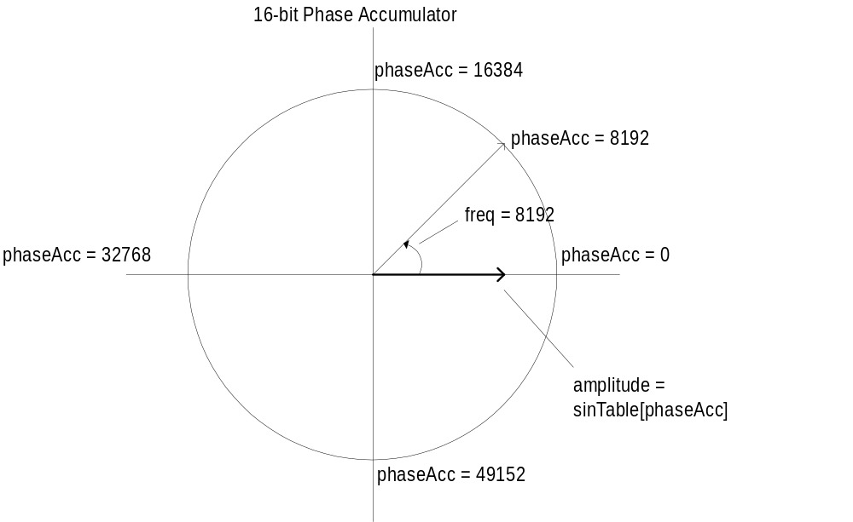
Virtual Peripheral Example: Signal Generation
On every pass of the Sine Generation code, a new value of phaseAcc is calculated
The new value is used to lookup a new value from the sine table
The new sine value is output using the software D/A
SineTable[PhaseAcc]
32
0
-32
phaseAcc Values →
Notes:
As shown in this diagram, the value in the freq variable is 8192.
On every sample, the phase is advanced by 8192.
The value 65536 lies where 2*pi would be, and this is the point at which the sine wave repeats itself.

Slide 27
Implementing a Virtual Peripheral

Slide 28
Implementing a Virtual Peripheral
Using the techniques in the Virtual Guidelines Document, implement the Virtual Peripheral
  Start with the Virtual Peripheral Guidelines Source Code Template.
    This template includes Virtual Peripheral Guidelines in it’s comments, and will enable you to get up to speed quickly.
    As is, the template is an executable program.
    Includes the Virtual Peripheral Multithreader

Slide 29
Implementing a Virtual Peripheral
Choose a sampling frequency for the Virtual Peripheral.
  Make sampling frequency flexible by including constants to adjust for any sample rate:
UART1_Fs = 232558 ; How often is the UART Virtual Peripheral
; executed?
UART1_Baud = 57600 ; Baud rate is 57600bps
Or
Fs = 9600 ; sampling frequency for DTMF detection
Bits = 16 ; 2^16 is the value of the phase accumulator
BitsVal = 2<<(Bits-1)
f697Lo equ ((BitsVal * 697)/Fs) & $0ff ; low 8 bits of 16 bit constant
f697Hi equ ((BitsVal * 697)/Fs) >> 8 ; high 8 bits of 16 bit constant

Slide 30
Implementing a Virtual Peripheral
Use a low sampling rate. This allows for easy integration with many VP’s
Use the ISR Multithreader. This allows for easy cut-and-paste integration with other VP’s
Use a common sample rate. Some VP’s require very accurate timing (UART). Use a multiple of the strictest VP’s ideal sample rate.
  Example: 19200bps UART. Use 19200Hz * 16 = 307200Hz

Slide 31
Implementing a Virtual Peripheral
Use the ISR Multithreader. This allows for easy cut-and-paste integration with other VP’s
The ISR Multithreader will run one of 16 or 24 threads on each pass of the ISR.
Fast Virtual Peripherals can be run more often than slow Virtual Peripherals
Sample rate of each thread is adjustable by changing the contents of a lookup table.

Slide 32
Implementing a Virtual Peripheral
_bank isrMultiplex ;1
inc isrMultiplex ;1; toggle interrupt rates
mov w,isrMultiplex ;1
jmp pc+w ;3
jmp isrThread1 ;3,9 cycles. isrThread1 runs the UART
jmp isrThread2 ;
jmp isrThread3 ;
jmp isrThread4 ;
jmp isrThread1 ; Call this thread 4 times/cycle for an
; execution rate of ISR_rate/4
jmp isrThread5 ;
jmp isrThread6 ;
jmp isrThread7 ;
jmp isrThread1 ;
jmp isrThread8 ;
jmp isrThread9 ;
jmp isrThread10 ;
jmp isrThread1 ;
jmp isrThread11 ;
jmp isrThread12 ;
jmp isrThread13 ;

Slide 33
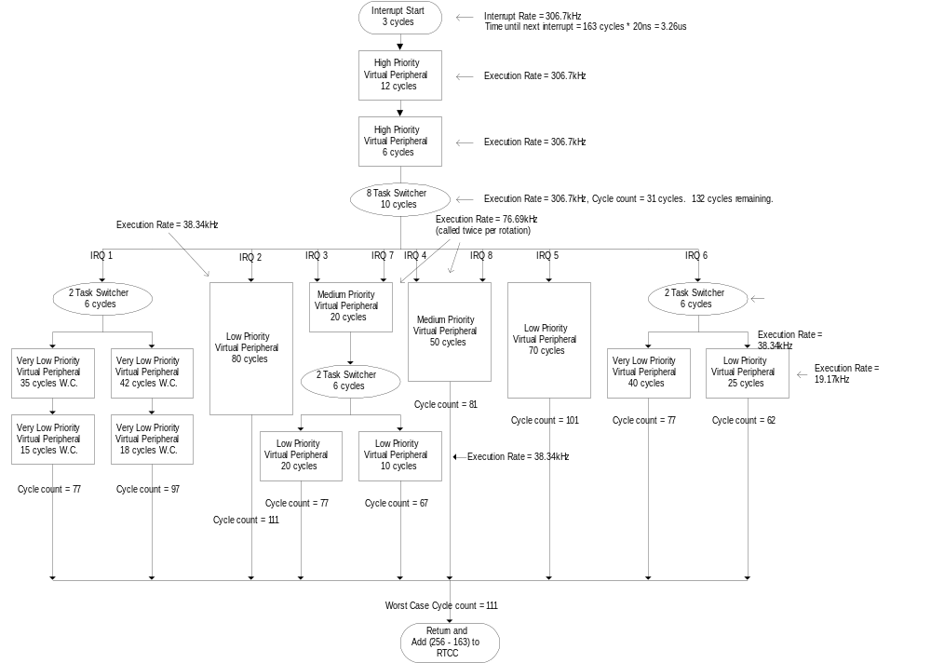
Implementing a Virtual Peripheral

Slide 34
Implementing a Virtual Peripheral
For integration with other VP’s, choose a multiple of the sample rate of the Virtual Peripheral with the strictest timing requirements.
  Example: 19200bps UART. Use 19200Hz * 16 = 307200Hz
Choose an oscillator frequency that will allow you enough cycles perform all the tasks required in the ISR at a high enough rate.
  For this example, choose 50MHz.
  Allows 50MHz/307200Hz cycles per interrupt
  162.76 cycles per interrupt
Choose a RETIW value:
  Round 162.76 cycles to 163.

Slide 35
Implementing a Virtual Peripheral
Calculate your actual Interrupt Frequency:
  50MHz/163 cycles = 306748Hz
This is your basis for all the calculations relating to the sample rate of the Virtual Peripheral.
All of the VP’s in the application will be sampled at this rate or at a divide down of this rate: IE:
306748Hz, 76687Hz, 19171Hz, 4792Hz

